Slide 1
Project Presentation
Paper Boy
Presented By: - Palak Srivastava
BCA – 6 Semester

Slide 2
Problem Statement
When the students and professionals wants to get the daily updated news regarding various fields like : -Entertainment , Politics , Education , Sports , etc.
Reading newspaper is Time Consuming process and also Costly , they uses Internet to get the updated news.
But with this the problem is that , they need to visit hundreds of websites or pages.
User can not fully Satisfied with the news and can not get fully knowledge about the respective fields.

Slide 3
Introduction
Paper Boy is a word that comes from RSS Feed Technology. RSS (Rich Site Summary) is a type of News web feed.
Online Paper Boy system allows customers to read up to date news related to many fields like Entertainment , National , International , Business , Bollywood , Politics , Sports , Education etc. , without any payment .
They can also contact us to give suggestions and can also give us feedback related to our site.
RSS feeds also benefit users who want to receive timely updates from favorite websites or to aggregate data from many news sites.

Slide 4
Objective
The main objective of Paper Boy is that to provide all type of instant and important news related to business world, world sports, national, education etc.
Those people who don’t have time to read newspaper and always linked with internet can get more informative.
Publish news about local region, town, city, state, national, and inter-national. End user can upload news from anywhere at any time at any time through web, mobile, tablets, etc. with registered their login& password.
Professionally publish online news publication. Corporate press releases, or manage other content without technical expertise.

Slide 5
Data Flow Diagram

Slide 6
Level 0
Profile Details
Success / error Message
Search Query
Login Credentials
Paper Category List
Success / Error Message
RSS Base Newspaper
Readers List
User
RSS Field
User
User
Paper Boy
Notification Message
Review Details
Admin
Notification Message
Review List

Slide 7
Search Query
Level 1
Category List
Category Mngmnt
New Category Details
Category List
Search System
User
3.0
2.0
D2
Category
Admin
RSS Feed Mngmnt
RSS News Feed List
RSS Feed Info
Update Query
User profile System
4.0
New Notification Message
Notification
System
Profile Details
Success/Error List
Update Query
D1
User
1.0
Notification Message
5.0
To Be Continued….

Slide 8
User
Admin
Review & Rating
Review/ Rating Details
D3
Review
Success/Error List
6.0
Review Rating List

Slide 9
Sign Up system
Success/ Error Message
Level 2
Profile Info
Success/Error Message
1.1
D2
User
Profile Info
Profile Management
Login Credentials
Login System
Login Credentials
User
confirm Message
Confirm Msg
1.o
Update Profile Query
1.2
Success/Error Message
Update Profile
Update Query
Message
1.3

Slide 10
Entity Relationship Diagram

Slide 11
U_id
email
Name
password
create
1
User
1
Profile
M
Search
Upload Up
RSS feed
M
Name
C_id
Name
A_id
M
Upload Up
1
Category
Admin

Slide 12
Project Modules
Profile Management :- User can create their profile in this modules.
Search System :- User passes the search Query and provided by the category list.
Category Management :- Admin manages the category in this module
RSS feed Management :- In this module Admin pass the update Query and user is provided by the RSS news Feed List.
Notification:- Any update or message show in this module.
Review & Rating:- The user send feedback and rating in this module.

Slide 13
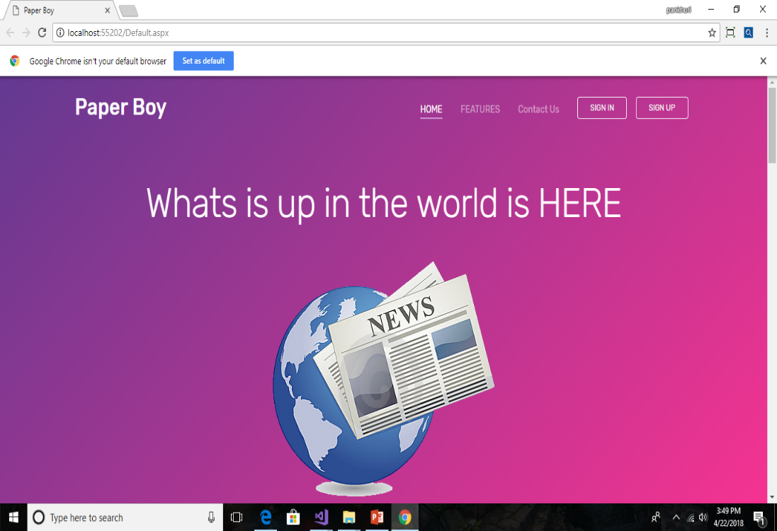
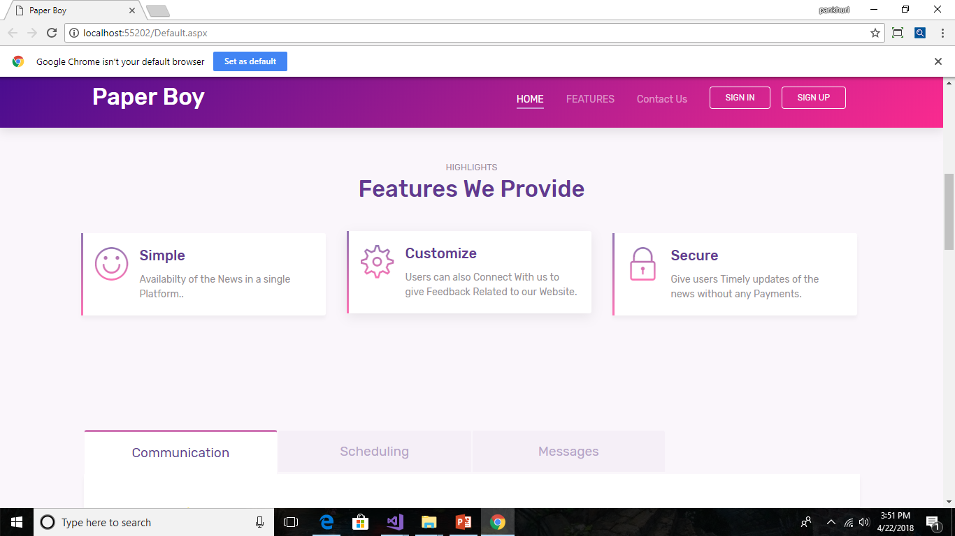
Home Page

Slide 14
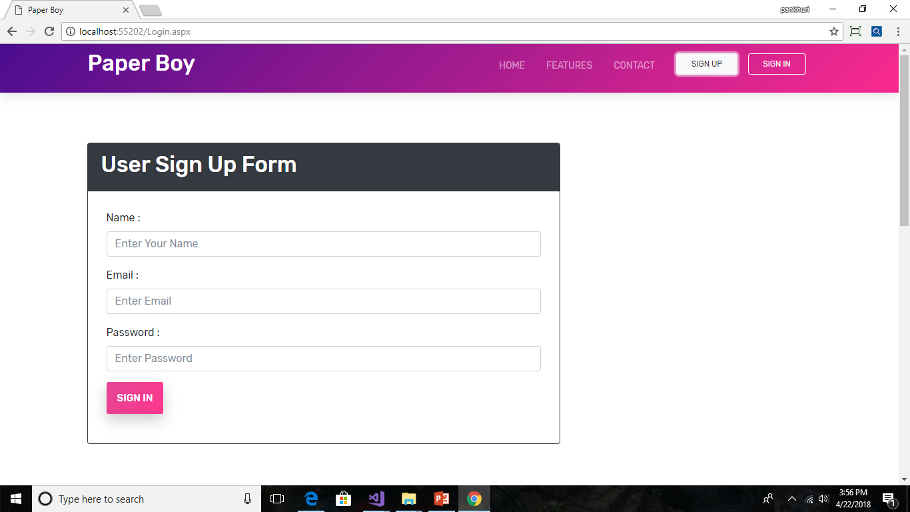
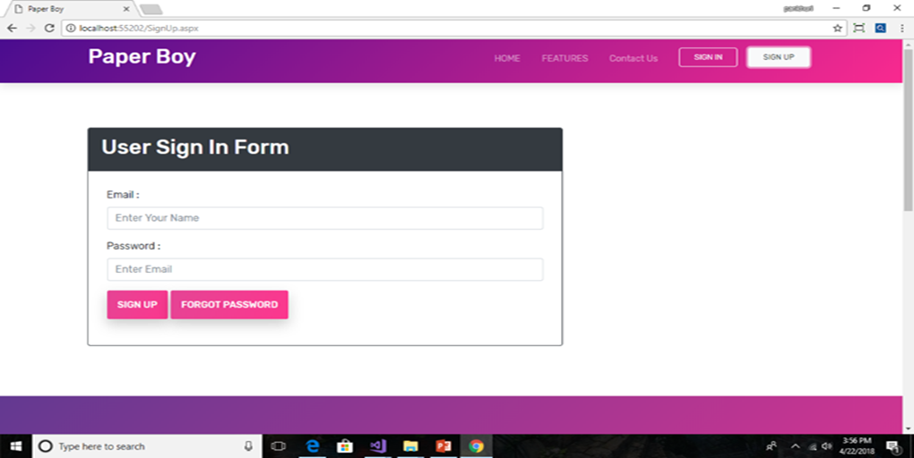
Sign In /sign up form

Slide 15
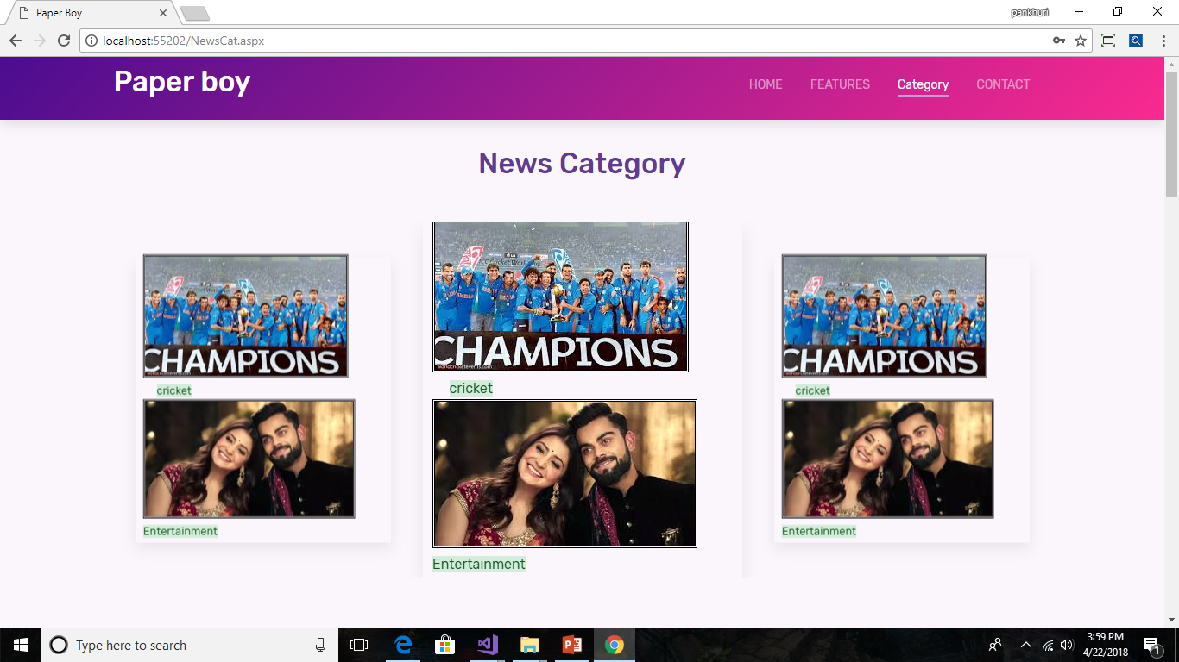
Category Page

Slide 16
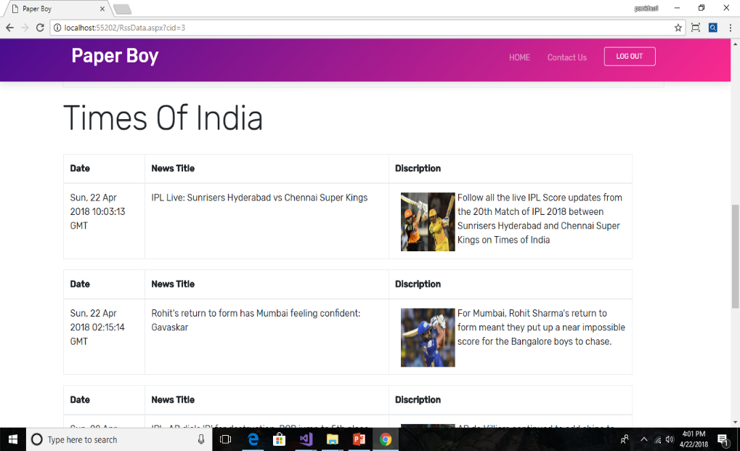
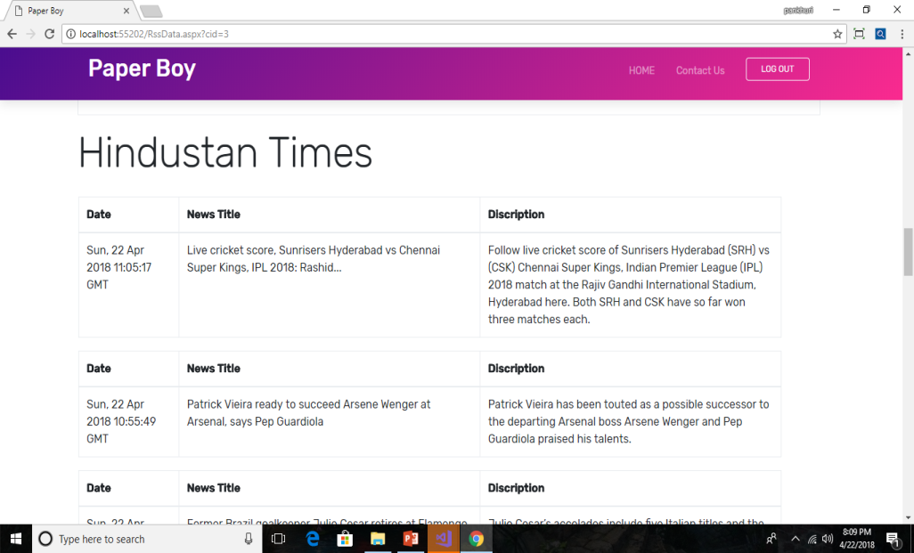
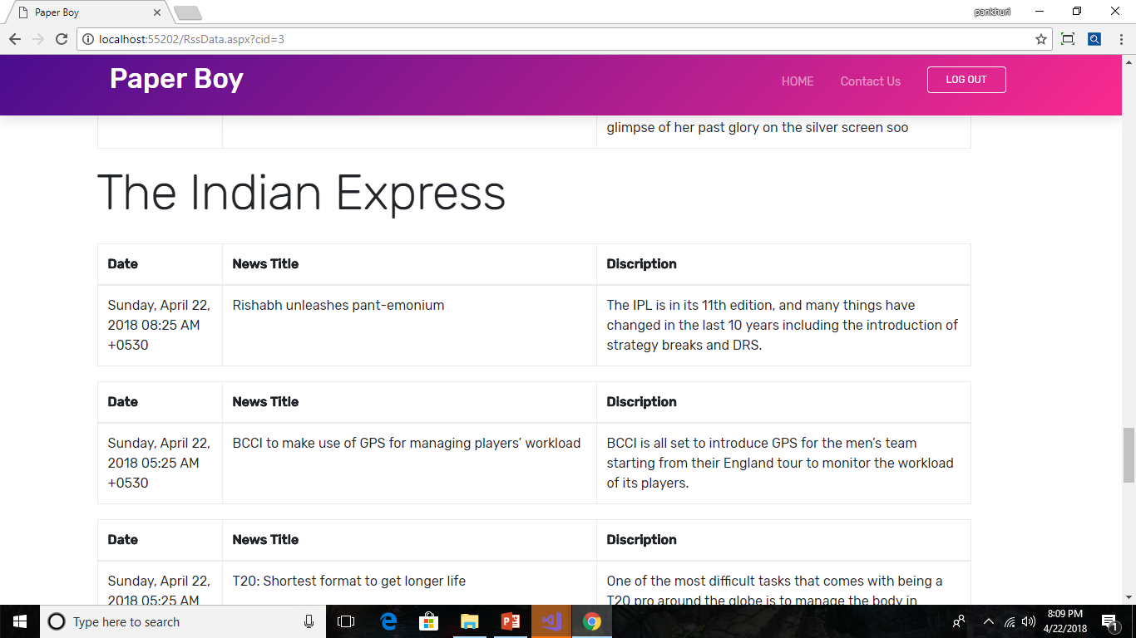
News Page

Slide 17
Conclusion
The project Paper Boy will provide flexibility to the users as they can access the desired news whenever they want.
There is no Limitation of the place and medium .
News are available in various Category such as :- Entertainment , Business, sports , health etc.
All the different category news are available of the three different newspaper :- Times of India , Hindustan times , Indian Express.

Slide 18
Thank You
For your Patience…

